Slide 1

Car Sales Trend Prediction
using
Linear Regression
Karthikeyan G - C0911147
Bhavani Ch - C0901954
Shravya P - C0910891
Vakula A - C0911182
Deepak M - C0904124

Slide 2
Agenda
Introduction
Data Analysis
Machine Learning
Linear Regression in Machine Learning
Machine Learning Workflow
Data Visualization
Predicting Test Result

Slide 3
Introduction
Car Sales Trend Prediction model aims to analyze the past car sales data and predict the future car sales trend considering different attributes associated with the car.
Our model uses a dataset that lists car brands, price of the car, mileage of the car, type and model of the car and other characteristics, customers will look while purchasing a car.
Using this data set, we have developed a Linear Regression model that aims to predict car sales trend based on different characteristics.

Slide 4
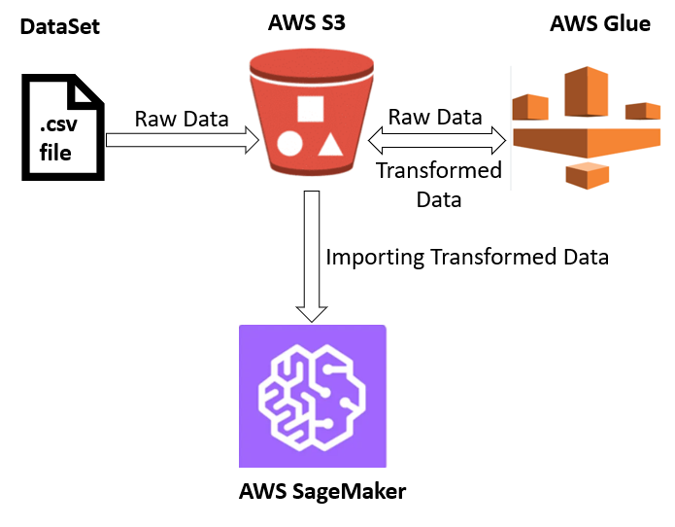
AWS Architecture
Figure 1: AWS Service & Components

Slide 5
Architecture
AWS Service & Components:
AWS S3 - Imported the raw source file in the Amazon S3 bucket.
AWS Glue - Used for data cleaning and transformation of the raw data as per the requirement.
AWS SageMaker - Used to implement the code, train and test the linear regression model.

Slide 6
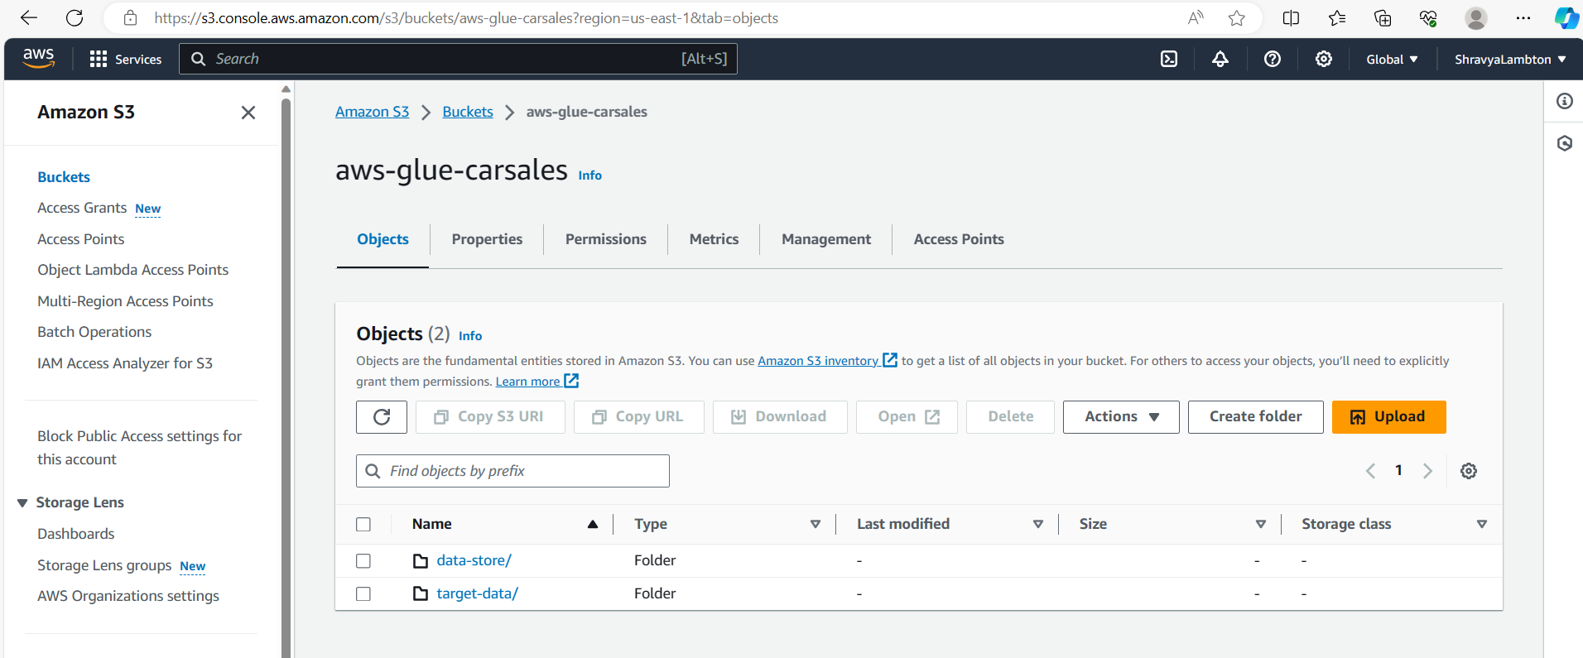
AWS S3
Input data source
Transformed output from the AWS Glue

Slide 7
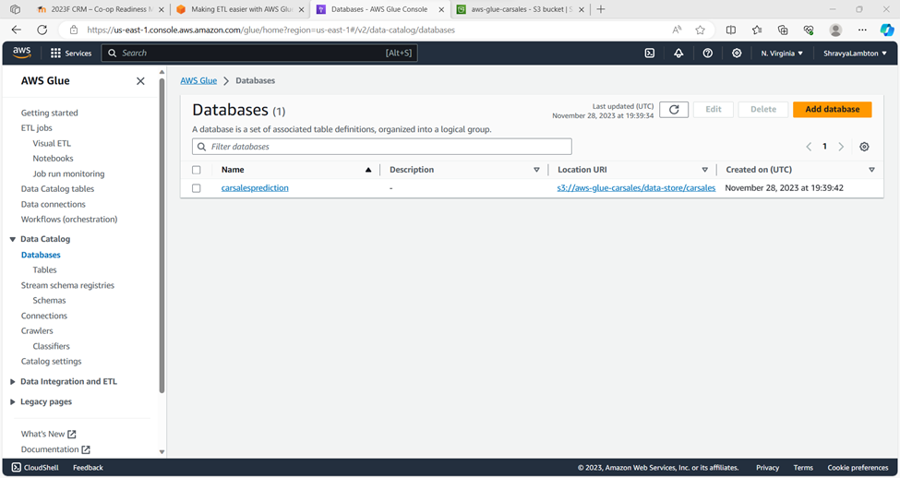
AWS Glue
Creating user role for utilizing the service.
Creating database mapping S3 URI location.

Slide 8
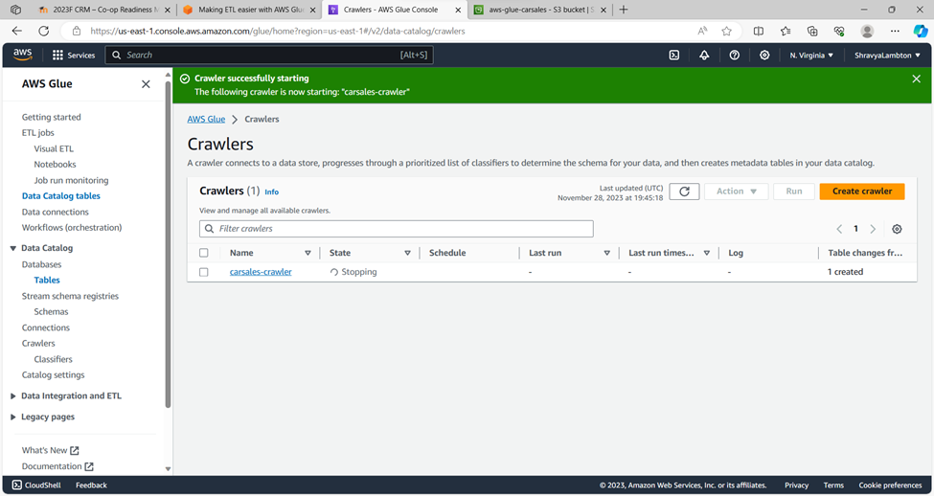
AWS Glue (1)
Creating the crawlers for grouping and cataloging the datasource and their metadata.

Slide 9
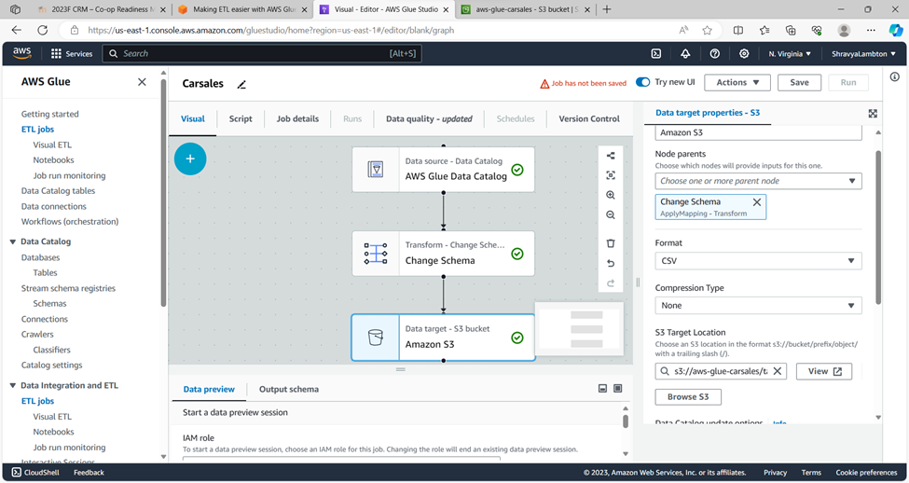
AWS Glue (2)
Creating the ETL job for the data transformation and formatting

Slide 10
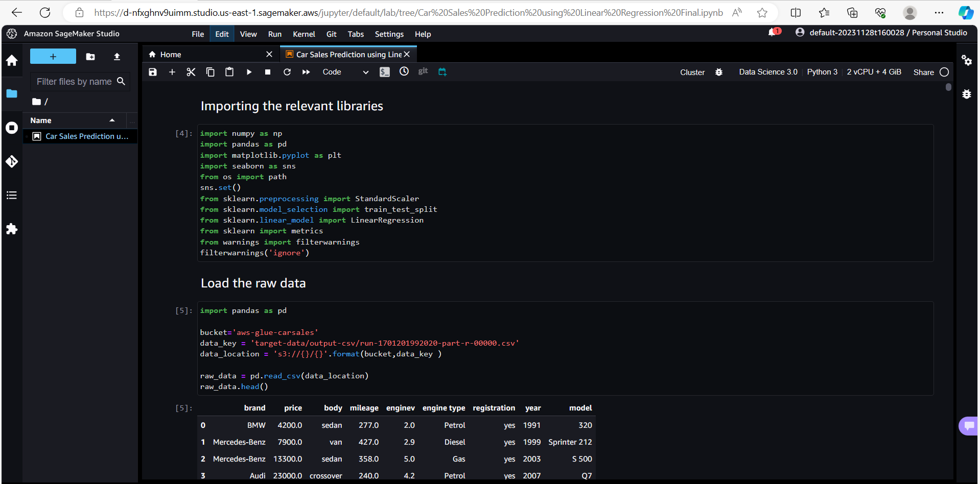
AWS SageMaker
Used to implement the python code with the data read from the AWS S3 to train and test the model

Slide 11
Machine Learning
Machine learning is a subset of AI, which enables the machine to automatically learn from data, improve performance from past experiences, and make predictions.
The key idea behind machine learning is to allow computers to automatically discover patterns, make decisions, and improve their performance on a specific task through experience.

Slide 12
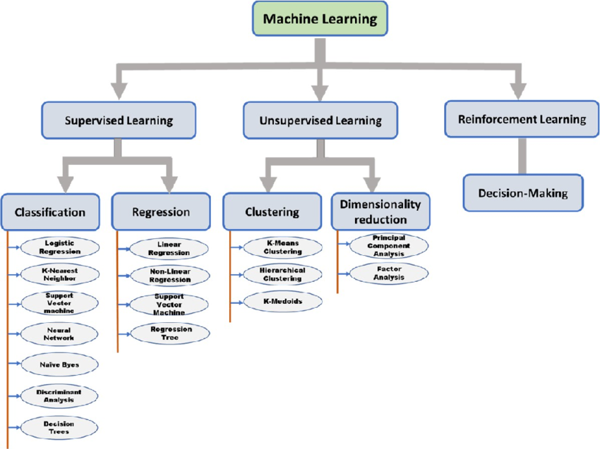
Linear Regression in Machine Learning
Figure 2 - Machine Learning Types FlowChart (Ref 1)

Slide 13
Regression
Regression is a form of Supervised machine learning where we try to predict a continuous value based on some variables.
From the existing data the regression model then builds its knowledge base.
Some popular regression algorithms are :
Linear Regression
Non-Linear Regression.

Slide 14
Linear Regression
Linear regression is a type of supervised machine learning algorithm that computes the linear relationship between a dependent variable and one or more independent features.
In this model, we have considered number of the attributes for analysing the sales trend in the past by determining the key attributes - Dependent and Independent variable like Price, Model and Year as per the model designing requirement.

Slide 15
What is Data Analysis ?
The process of analyzing, cleansing, transforming, and modeling data to find relevant information, make predictions, and help in decision-making is known as data analysis.
It requires a range of methods and techniques to gain valuable insights from unprocessed data.

Slide 16
DataSet
Kaggle Machine Learning Repository: Car Sales Prediction data set
Url: https://www.kaggle.com/datasets/smritisingh1997/car-salescsv/data

Slide 17
Importing the Libraries
Pandas : We used pandas for data analysis and associated manipulation of tabular data in Data Frames
Seaborn : We used seaborn to plot graphs
Matplotlib: We used this library to create visualizations
Sklearn: We imported this library to do Linear Regression Algorithm
NumPY: We used to perform wide variety of mathematical operations on arrays.

Slide 18
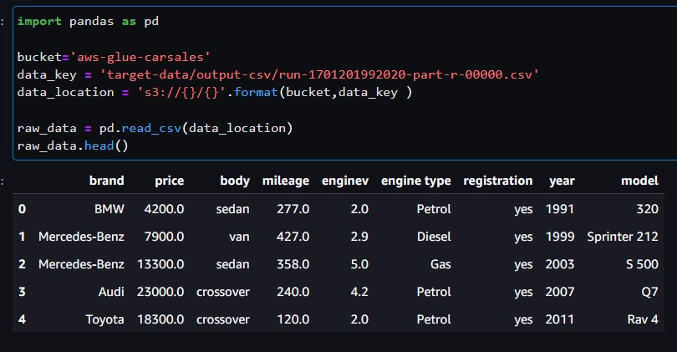
Importing the dataset
Read the Data set using pandas library
pd.read_csv command creates a dataset object which contain the contents of the .csv file.
Using the head() function, we display the first 5 rows of the dataset

Slide 19
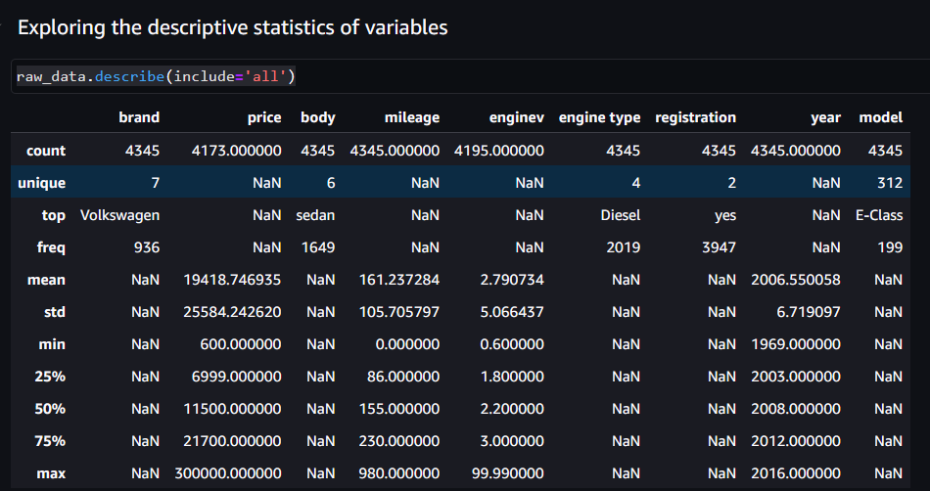
Describing/Exploring the dataset
Using describe() function to get the over all dataset statistics with count, uniqueness, frequency, mean, min, max, Q1, Q2, Q3

Slide 20
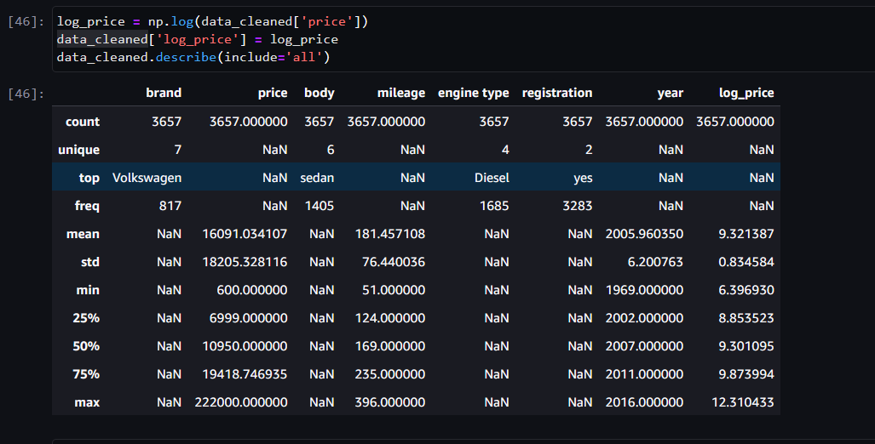
Transforming Dataset
Using log transformation from numpy to transform the variable price as log_price for training and testing the model.

Slide 21
Splitting the data into training and test data
30% of the data will be marked as the Test data set.
70% will be used for training as the Training data set.
So, out of the 4000 rows approximately, 1000 will be assigned as test set and the remaining 3000 will be used for the training purpose
train_test_split() function: It is used to split our data into train and test sets.

Slide 22
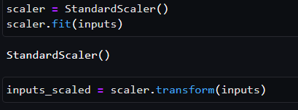
Standard scaling
In order to scale the values of X down to a narrower range, we must take standard scaling, which will speed up the program using StandardScalar() function.
It helps to normalize the data within a particular range.

Slide 23
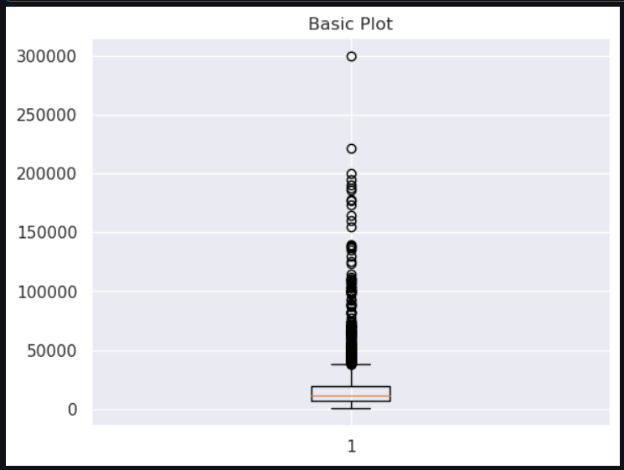
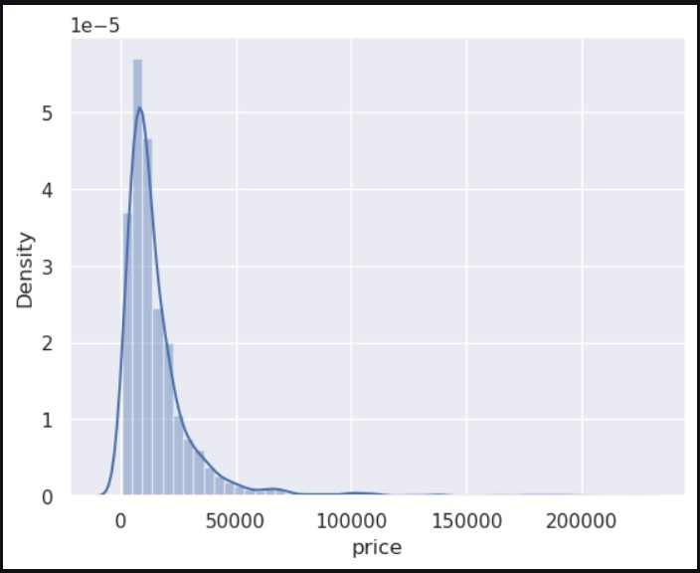
Data Visualization
Figure 3: Box Plot of the Price
Figure 4: Dist Plot of Price Distribution
(Univariate distribution of data)

Slide 24
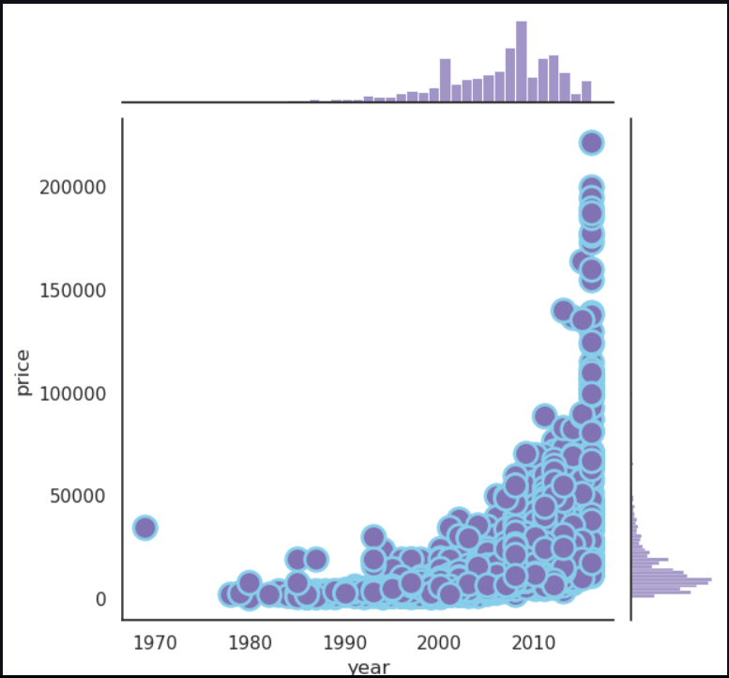
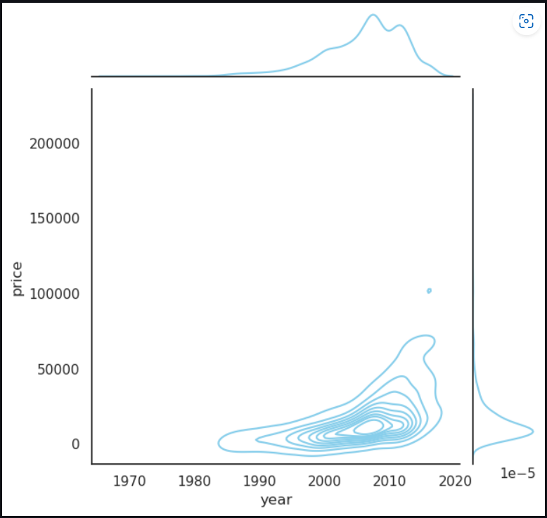
Data Visualization(1)
Figure 5 & 6: Joint Plot of Price vs Year

Slide 25
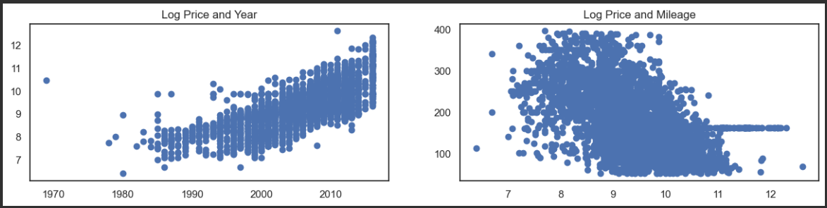
Data Visualization
Figure 7: Scatter Plot of Price vs Year
Figure 8: Scatter Plot of Price vs Mileage

Slide 26
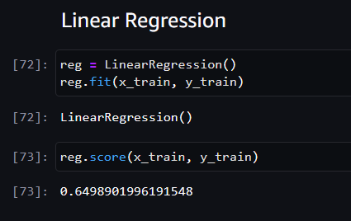
Linear Regression Model Training on the dataset
In this step, we use the Linear Regression Class to fit the training set to our model
Here we have choose log_price as dependent variable of the other attributes that are taken into the consideration
LinearRegression() function of scikit-learn uses the training data as an input to train the machine learning model.

Slide 27
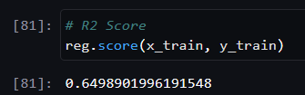
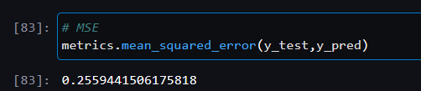
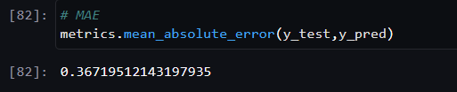
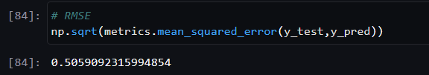
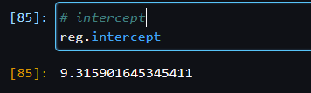
Summary Statistics
R2 Score: MSE: Mean Square Error
MAE: Mean Absolute Error RMSE: Root Mean Square Error
Intercept:

Slide 28
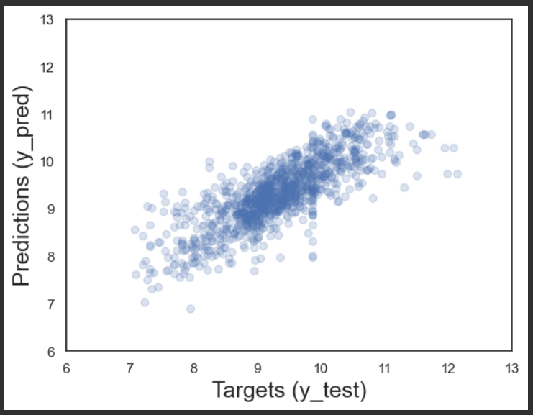
Visualizing the Result
We have used the scatter plot to the show distribution of the predicted result set using the matplotlib
Figure 9: Final Prediction

Slide 29
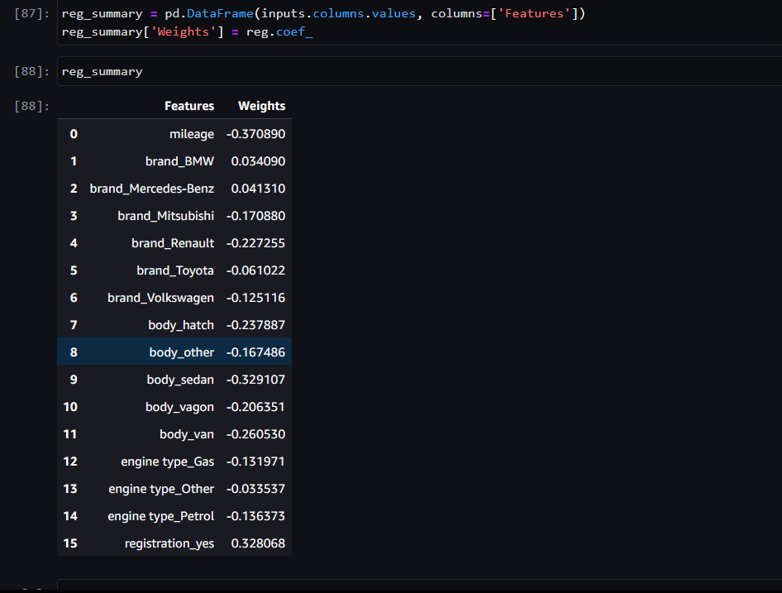
Regression Summary
Features with respect to their regression coefficient are listed below.
Each feature has either negative or positive coefficient with respect to the target variable.
Figure 10: Features vs Regression Coefficient

Slide 30
References:
Ref 1) Figure 2 - Source URL: https://www.researchgate.net/publication/366359344/figure/fig2/AS:11431281110663402@1672677311128/Flowchart-of-the-types-of-machine-learning-techniques.png

Slide 31
THANK YOU

